Slide 1
Deep Semantic Ranking Based Hashing for Multi-Label Image Retrieval
Fang Zhao, Yongzhen Huang, Liang Wang, Tieniu Tan
Center for Research on Intelligent Perception and Computing Institute of Automation, Chinese Academy of Sciences
CVPR 2015

Slide 2

Discounted Cumulative Gain (NDCG)
Discounted cumulative gain (DCG) is a measure of ranking quality
DCG measures the usefulness, or gain, of a document based on its position in the result list
Two assumptions are made in using DCG and its related measures
Highly relevant documents are more useful when appearing earlier in a search engine result list (have higher ranks)
Highly relevant documents are more useful than marginally relevant documents, which are in turn more useful than irrelevant documents

Slide 3

DCG and Normalized DCG
Normalized discounted cumulative gain (NDCG) measures the performance of a recommendation system based on the graded relevance of the recommended entities. It varies from 0.0 to 1.0, with 1.0 representing the ideal ranking of the entities.
where p is the truncated position in a ranking list.

Slide 4
DCG and Normalized DCG
Presented with a list of documents in response to a search query with relevant values
relevance scores: 3,2,3,0,1,2 as
DCG₆ =7+1.892+3.5+0+0.387+1.069=13.848
an ideal ordering for the given query: 3,3,2,2,1,0
IDCG₆ =14.595
NDCG₆ =13.848/14.595=0.95

Slide 5
Principles
Similarity-preserving
Balance
Independence

Slide 6
Motivation
most of existing hashing methods are designed to handle simple binary similarity other than multilevel semantic structure of images associated with multiple labels
the limitation of semantic representation power of hand-crafted features such as semantic information loss in the hand-crafted features like SIFT feature extracting.

Slide 7
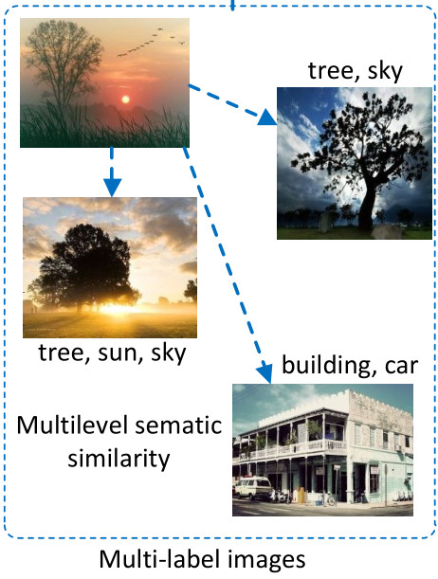
Multi-label Images
Images are usually simultaneously associated with multiple semantic labels, and in this case the similarity relationship is usually relevant to the number of common labels that two images have. Consequently, a multilevel measure (such as very similar, normally similar and dissimilar) is required to describe the similarity, which cannot be handled well by the prior methods.

Slide 8

The ground-truth ranking list in DRSH
The length of the ground-truth ranking list used for training is set to 3, which can be created by taking one item sharing all the labels with a query, one item without any common label and one item having at least one common label
$$q:\left(q′, x_{i}, x_{j}\right)$$

Slide 9
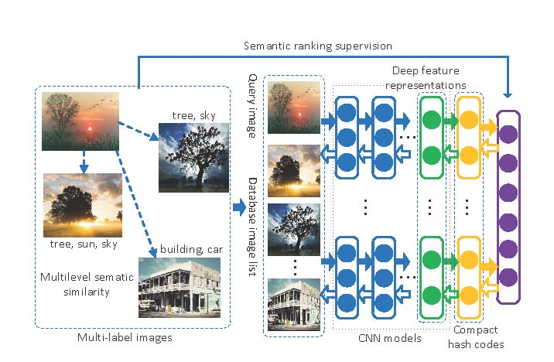
Overall Architecture of DRSH
Hash functions consist of CNN and binary mappings of the feature representation from the top hidden layers of CNN.
Deep hash functions using CNNs to jointly learn feature representations from raw pixels of images and their mappings to hash codes.

Slide 10
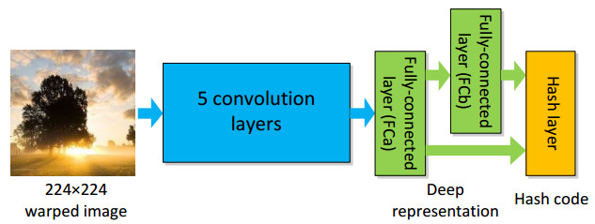
The structure of deep hash functions
An input image is first transformed to a fixed size, and then goes through five convolution layers and two fully-connected layers, which provides a deep feature representation. Finally, the hash layer generates a compact binary code. The hash layer is also directly connected to the first fully-connected layer (FCa) in order to utilize diverse feature information biased toward visual appearance.

Slide 11
Notation
a dataset
a set of class labels L = {1, ..., C}
data point x ∈ R^{D} is associated with a subset of labels Y.
a hash function h : R^{D} → {−1, 1} is treated as a mapping that projects a D-dimensional input onto a binary code.
hash functions h(x) = [h₁(x), h₂(x), ..., h_{K}(x)] (K<<D)

Slide 12
Deep hash function
deep hash function where w denotes weights in the hash layer, fa(.) and fb(.) denote feature vectors from the outputs of the layers FCa and FCb respectively.
To obtain a K-bit binary code, h(x; W) =[h(x) = [h₁(x), h₂(x), ..., h_{K}(x)] can be computed.

Slide 13
Supervised Optimization with Surrogate Loss
Adding adaptive weights related to the similarity levels
Balance Item
Independence

Slide 14
Notation
a query q
a ranking list for q
M is the length of the ranking list
[.]₊ = max(0, .)
d_{H}(., .) is the Hamming distance
δd_{H} (h, h1, h2) = d_{H}(h, h1) − d_{H}(h, h2)
ρ is a margin parameter

Slide 15
Supervised Optimization with Surrogate Loss
Directly optimizing such ranking criteria is intractable, which involves minimizing nonsmooth and multivariate ranking losses
This surrogate loss is a convex upper bound on the pairwise disagreement which counts the number of incorrectly ranked triplets

Slide 16
Optimization
Ranking Loss
margin parameter
users usually pay most of their attentions to the results on the first few pages.

Slide 17
Supervised Optimization with Surrogate Loss
Adding adaptive weights related to the similarity levels
Balance Item
Independence

Slide 18
Experiments
Two multi-label benchmark datasets:MIRFLICKR-25K and NUSWIDE
Nq (mini-batch size for gradient descent) to 128
The regularization parameter α and β are set to 1 and 5e−4 respectively
The length of the ground-truth ranking list used for training is set to 3

Slide 19
Datasets
MIRFLICKR-25K
2000 as testset; 23000 as trainset
38 concepts
3857-dimensional feature vector:
Pyramid Histogram of Words (PHOW)
Gist
MPEG-7 descriptors
NUS-WIDE
226,265 of 269,648
5000 as testset
81 concepts
1134-dimensional feature vector:
Bag of words based on SIFT
color histogram
color correlogram
edge direction histogram
wavelet texture
block-wise color moments

Slide 20
Evaluation Criteria
Normalized Discounted Cumulative Gain (NDCG)
mean Average Precision (mAP)
Average Cumulative Gain (ACG)

Slide 21
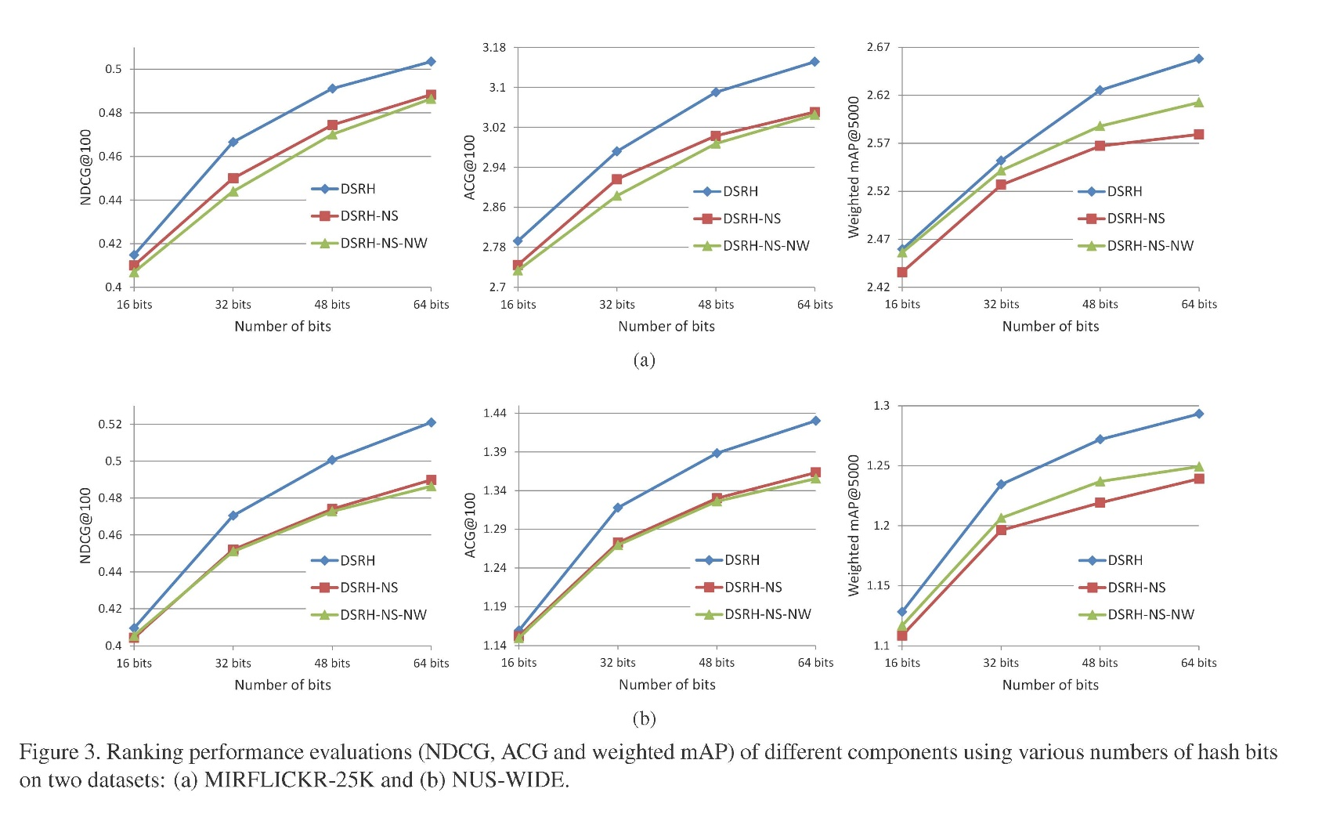

Slide 22
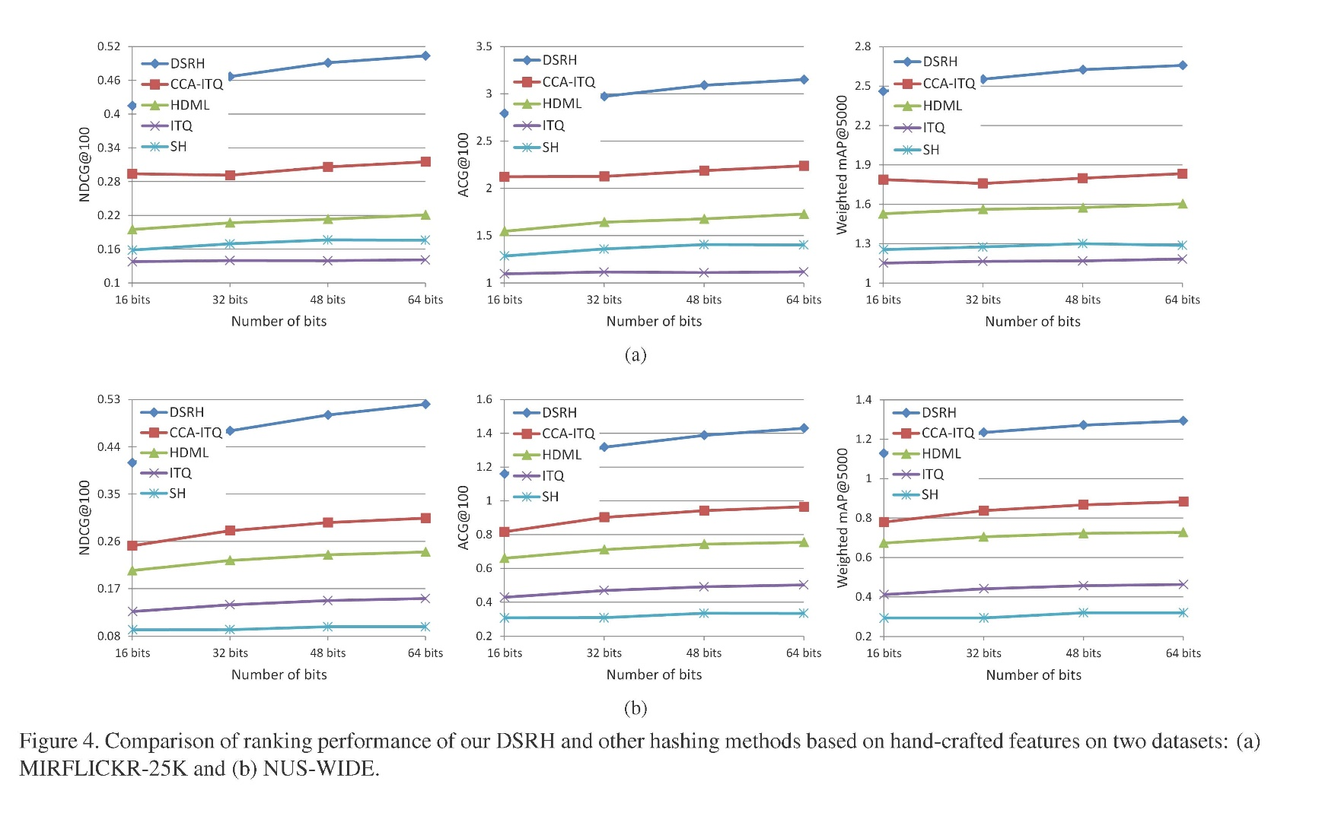

Slide 23
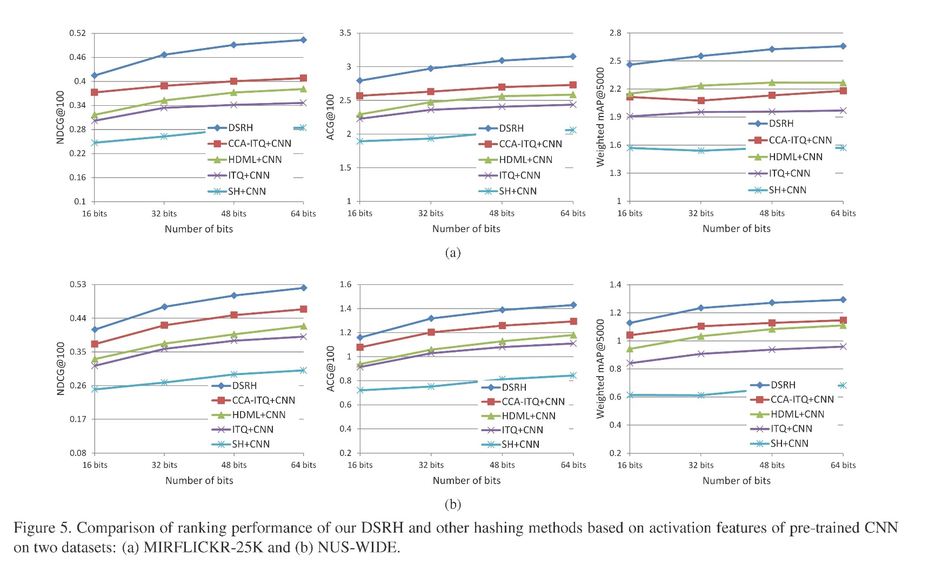

Slide 24
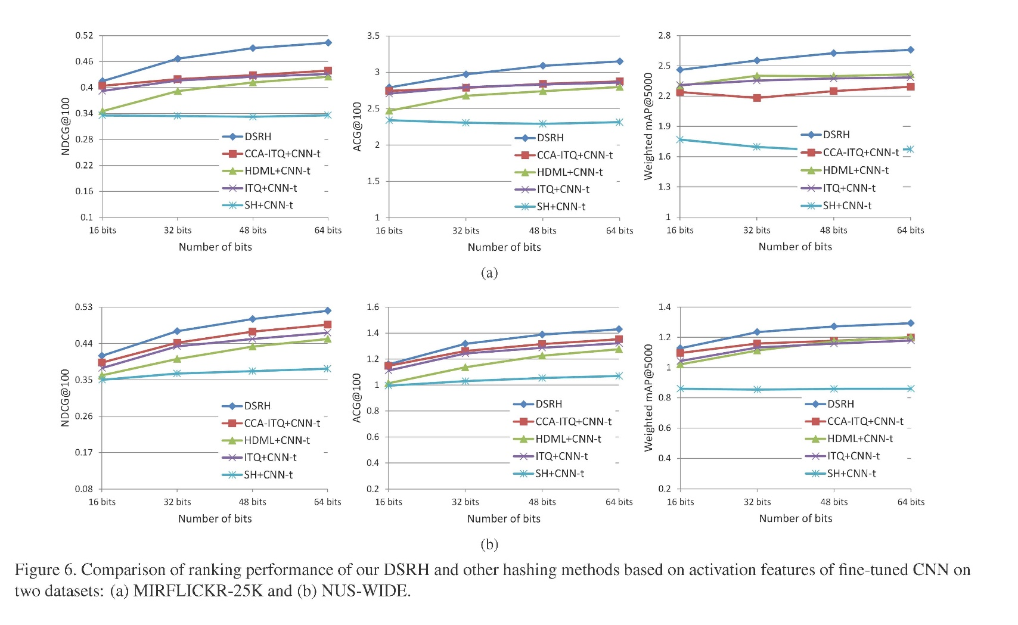

Slide 25
Conclusion
A novel hash function learning formwork is proposed to combine semantic ranking and deep learning model to address the problem of preserving multilevel semantic similarity between multilabel images.
The ﬁrst time to exploit deep convolutional neural network with listwise ranking supervision for hashing. CNN to avoid hand-crafted features
Our method achieved the state-of-the-art performance in terms of ranking evaluation metrics.

Slide 26
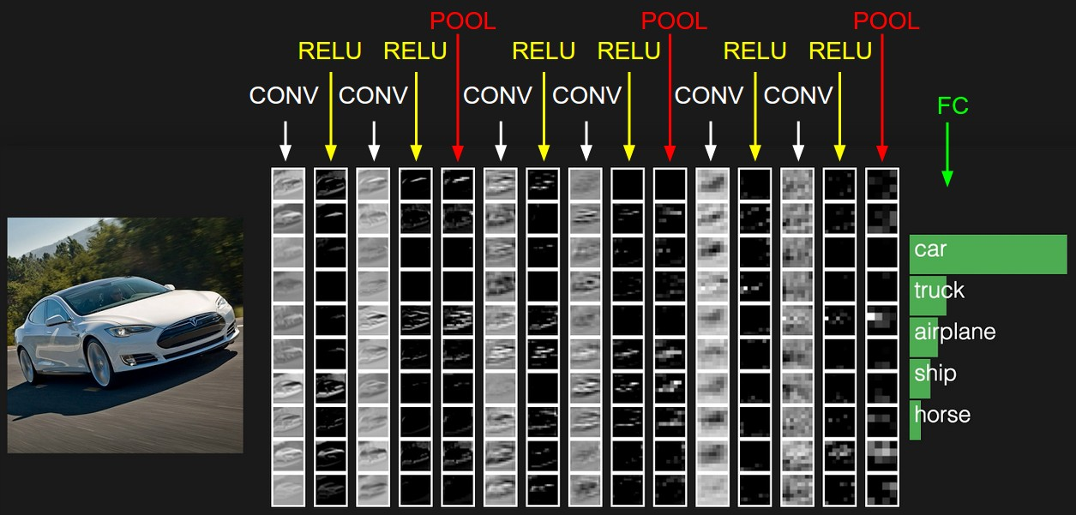
CNN

